Slide 1
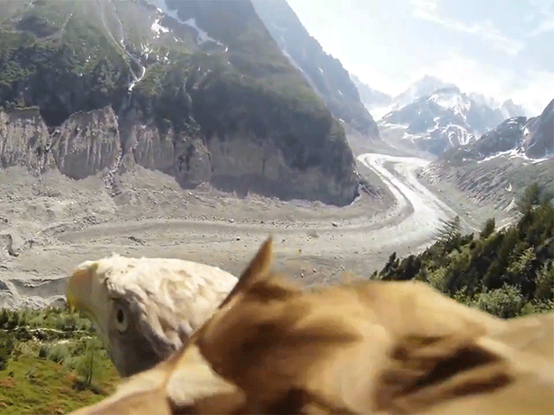
Lessons from
God’s Creatures pt. 1

Slide 2
Note: After you download the slideshow, you may also need to download some videos from YouTube & add them into this PowerPoint. This tool can help you: Free YouTube Download
We present these messages in outdoor venues using the SonShineTent. Watch the video of our service that goes with this message, click here: http://campaignkerusso.org/?p=13935
We would love to know more about the people who download our lessons & sermons. We invite you to email us & let us know where & how you use them.
info@campaignkerusso.org

Slide 3
Welcome All

Slide 4
Let’s Begin with Prayer

Slide 5
Lessons from
God’s Creatures pt. 1

Slide 6
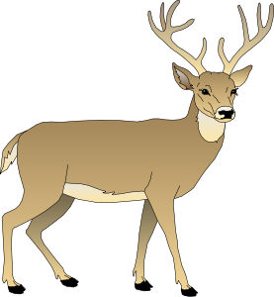
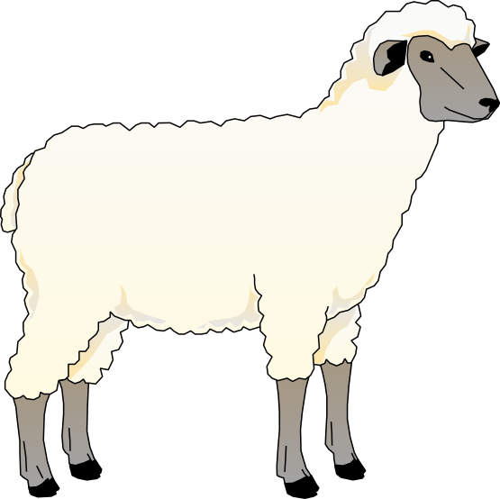
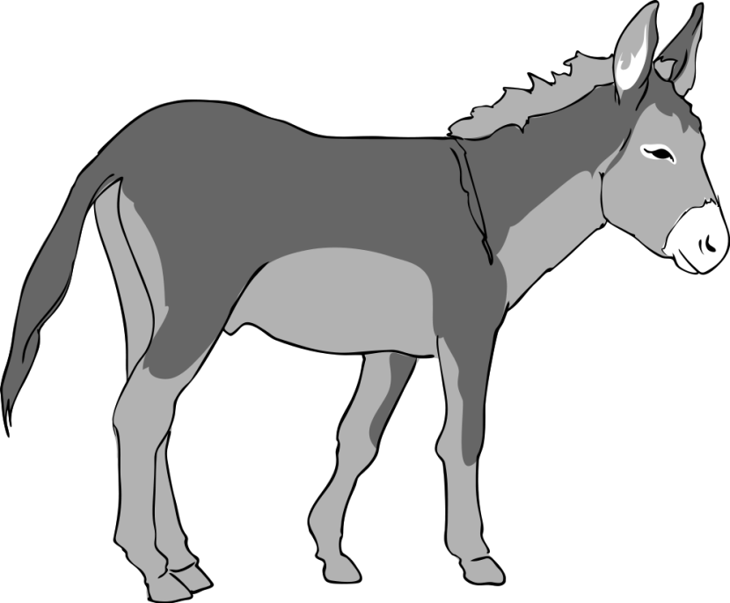
Part 1:
Lessons From Large Mammals

Slide 7
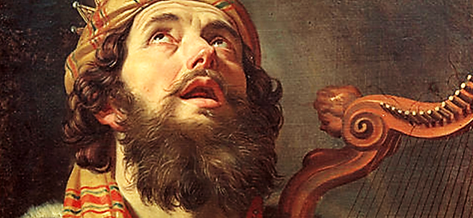
David wrote Psalm 18 to thank the Lord for getting him through every difficult and dangerous situation, including King Saul chasing him all over the desert!
“For the music director; by the Lord’s servant David, who sang to the Lord the words of this song when the Lord rescued him from the power of ALL his enemies, including Saul.” Ps. 18:1

Slide 8
Deer: Psalm 18 tell us that the believer’s steps are protected by God.
“He gives me the agility of a deer;
he enables me to negotiate the rugged terrain.”
Ps. 18:32-33 NET

Slide 9
Mountain Deer Feet are Steady & Sure Anywhere
Video Goes Here: Rock Climbing Goats/Deer Download Here:
https://www.youtube.com/watch?v=Hu8TJKMtmtI

Slide 10
Deer Questions:
Why did God give mountain deer special feet?
Why did David feel he had something like mountain deer feet?
Mountain deer get around rocks on steep cliffs. How can believers get through life’s many problems?

Slide 11
“As a deer gets thirsty for streams of water, I truly am thirsty for you, my God.”
Ps. 42:1 CEV
Believers thirst for God as deer thirst for water.

Slide 12
More Deer Questions:
What do deer thirst for?
What did David thirst for?

Slide 13
Song: As the Deer
Song Goes Here Title: As a Deer Download Here:
https://www.youtube.com/watch?v=5nrXkM-4VAM

Slide 14
Oxen & Donkeys: Love Their Owner
“Even the animals—the donkey and the ox—know their owner and appreciate his
care for them, but not my people Israel. No matter what I do for them, they still don’t care.” Isa. 1:3 TLB

Slide 15
Oxen & Donkey Questions:
How do oxen & donkeys feel about their good owners and why?
How were God’s people, Israel, different than the oxen and donkeys?
believers?

Slide 16
Video: Gentle Owner Training His Oxen
Video Goes Here Title: Gentle Trainer Download Here:
https://youtu.be/MclRxWYOfTg

Slide 17
More Oxen & Donkey Questions:
What did the gentle owner say he always wanted to do for his oxen?
Why does God want to talk to us?
How do the oxen & believers become perfected? believers?
What is the first & second most important commands ?
Why are these two commands also important for believers?

Slide 18
And…More Oxen & Donkey Questions:
How did the oxen react to the cat distraction?
What kind of distractions do believers have?
What was “Narayana” (the smaller ox) doing while she was concerned about the cat?
What does this teach believers about God’s voice?

Slide 19
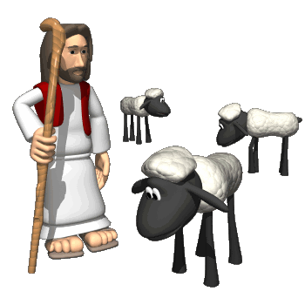
Sheep: Listen to their Shepherd
“My sheep recognize my voice, and I know them, and they follow me.” John 10:27 TLB

Slide 20
Sheep
Questions:
What do God’s people (God’s sheep) recognize?
Why do you think believers recognize God’s voice?
What does our Shepherd (Jesus) say He knows?
What do you think He knows about us?
When God’s sheep hear His voice, what do they do?

Slide 21
Video: Their Master’s Voice
Video Goes Here Title: Sheep Hear Master’s Voice Download Here:
https://www.youtube.com/watch?v=Coq_grSFlNs

Slide 22
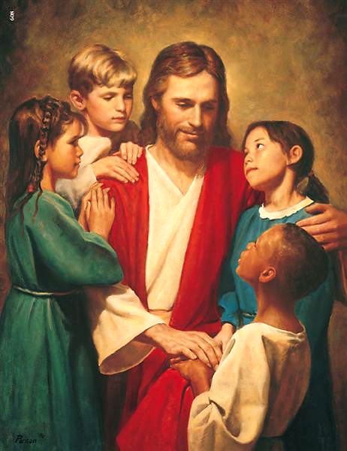
“Like a shepherd, God will tend the flock; he will gather lambs in his arms and lift them onto his lap…”
Isa. 40:11 CEB

Slide 23
One More Sheep
Question:
Where does God like to put His sheep?

Slide 24
Is Jesus
Speaking to You?
“They said to each other, ‘Did not our hearts burn within us while he talked to us on the road, while he opened to us the Scriptures?’”
John Wesley Said:
“…the preacher was describing the change which God works in the heart through faith in Christ and I felt my heart strangely warmed.”
Jesus makes His presence Known by a small voice!

Slide 26
What is the Sinner‘s Prayer?
This is a prayer we can pray when we are ready to admit we are sinners and need Christ’s forgiveness.
It must be prayed with faith in our hearts and a readiness to have a life-changing encounter with Jesus Christ.

Slide 27
A prayer of faith → Pray this prayer if :
If you never have before
You have in the past, but you think it would mean more today
You have been walking afar off and you want to come back
You want to set an example & show others how it is done
You just like to give your heart to Jesus again & again
Faith

Slide 28
We Declare Our Faith Publicly Because Jesus Declared His LOVE Publicly
“If you stand before others and are willing to say you believe in me, then I will tell my Father in heaven that you belong to me.” Mat 10:32

Slide 29
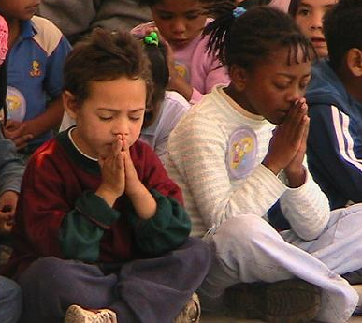
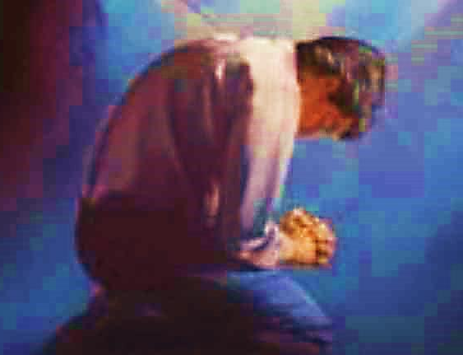
Three Important Questions
Do you want to know Jesus as your Savior right now?
Do you believe He died to save you from your sins & that He rose from the dead?
Do you believe that He is here, waiting to save you right now?

Slide 30
The Prayer of a Sinner Turning to Jesus
Dear Jesus, I know that I have sinned against You and that my sins separate me from You.
I am truly sorry.
Right now, I turn away from my sinful past .
Please forgive me, and help me to keep from sin.
I believe You died for my sins.
I Believe You rose from the dead, you are alive, and you hear this prayer from my heart.
I invite You Jesus to be both my Savior and the Lord of my life.
I want You to rule my life from now on.

Slide 31
“But some people did accept him. They believed in him, and he gave them the right to become children of God.”
John 1:12

Slide 33
“If you openly say, ‘Jesus is Lord’ and believe in your heart that God raised him from death, you will be saved.”
Rom. 10:9
What did you learn today?
What about God’s Animals?
What have you been thinking about God lately?
What do you want to tell others about Jesus?

Slide 34
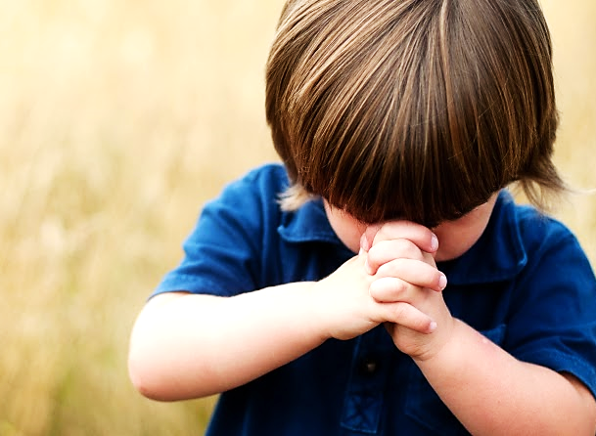
Let’s Close in Prayer

Slide 35
Note: After you download the slideshow, you may also need to download some videos from YouTube & add them into this PowerPoint. This tool can help you: Free YouTube Download
We present these messages in outdoor venues using the SonShineTent. Watch the video of our service that goes with this message, click here: http://campaignkerusso.org/?p=13935
We would love to know more about the people who download our lessons & sermons. We invite you to email us & let us know where & how you use them.
info@campaignkerusso.org

